Slide 1
Eonics Open Hack night #35
Introduction to Blazor
Blazor Fluxor Tailwind

Slide 2
Johan Stolk
Programming (games) since age 16:
Basic on a Vic 20/C64
Assembly on Amiga
C Unix/Dos gcc/djgpp
C++ Linux/Windows gcc
Java Eclipse, Android Studio
.NET Rider
Developing in .NET since 2002
Blazor since 2020
Still coding Games

Slide 3

Blazor
One language server/clientside: C#
One IDE: Visual Studio/Rider/VS Code
Faster development times, optimal code re-use
Full stack debugging client & server side
Component-based (similar to Angular)
Targets Web/Desktop/Mobile (ASP.NET, .NET MAUI)

Slide 4
Blazor options
Blazor WebAssembly
Blazor Server
Blazor Hybrid
Modern, mature, well-known C#
instead of java/typescript
Javascript interoperability possible
e.g. Chart JS, WebGL, Code Mirror, etc.

Slide 5
Blazor Server vs WebAssembly
Blazor WebAssembly
Runs client-side (Mono runtime and/or DLLs converted to WebAssembly)
Basic file hosting is sufficient
Installable as app (PWA) on desktop & mobile
Optional offline support possible using a local (in-browser) database (SqlLite with EF)
Optional AOT compilation to pre-compile WebAssembly
WASM code generated instead of MSIL
Blazor Server
The C# code stays & runs on the server (communication via SignalR)
Requires ASP.NET Core hosting
Pro: minimizes load on client, faster startup (thin client), all code on server (no decompile possible)
Con: latency if server connection not fast, no PWA, no offline support, server load

Slide 6

Progressive Web App
Runs in browser or as ‘app’
Easy install: (Browser: Apps Install / Android: Add to Home screen)
Runs in the browser's sandbox
safe for client
offline support possible (browser cache storage/service worker)
can't use local resources (input ports COM, USB, etc.)
.NET APIs that aren't applicable throw a PlatformNotSupportedException
e.g., accessing file system, opening a socket, threading
Deployment updates requires dealing with browser cache storage
Optional: can receive push notifications from server
Optional: could use local database SQLite to work offline

Slide 7
Blazor Hybrid
Blazor UI rendered to an embedded WebView control (WPF / .NET MAUI / WinForms)
Native Apps (Android, iOS) or Native Desktop applications (use USB port, etc.)
Re-use web UI in native environment, optionally calling native code
Reduce app development time, re-use skills and code
Access to device ports (USB, COM port, etc.)
.NET MAUI
MAUI = multi-platform app ui (for mobile & desktop)
The future of cross platform UI & client apps with .NET Windows, Mac, Linux, Android, iOS

Slide 8
Blazor United (Coming in .NET 8)
Combines advantages of Razor Pages, Blazor Server and Blazor WebAssembly into one
Blazor components as a single architecture for all web UI scenarios:
plain HTML rendering
interactive server-side
interactive client-side (WebAssembly)
ability to switch between different rendering modes and mix them in the same page
Pro ‘auto mode’: use Blazor Server for the initial load of a page giving a near immediate startup,
while loading the WebAssembly assets in the background and switching to WASM without constant signal R connection requirement.

Slide 9
Blazor Hands-on
Use 01CreateEmptyBlazorApp as a starting point
Created with Visual Studio: Blazor WebAssembly App Empty
Open 02FirstBlazorComponents solution and start it
Follow the instructions and code along in your own project

Slide 10
Tailwind for Modern Responsive UI
Tailwind: a utility-first CSS framework https://tailwindcss.com
CSS is hard to understand
Tailwind is a much cleaner solution
you still have access to css
Configurable for custom classes
colors, fonts, any other custom class (using @apply)
JIT compiled to minimal CSS size, easiest with tailwind.exe:
https://github.com/tailwindlabs/tailwindcss/releases
as this does not require npm install

Slide 11
Tailwind for Modern Responsive UI
https://play.tailwindcss.com
Mobile first: breakpoints sm (640), md (768), lg ..
Play website: drag splitter - switch mobile/desktop
Dark mode option
Customizable colors, fonts, plugins, etc.
p-2 padding mx-8 margin x direction
l=left, r=right, t=top, b=bottom
pt-2 pb-8

Slide 12
Blazor API (default setup)
Create a hosted solution using
dotnet new blazorwasm -ho -o blazorwasmhosted
(remember to start server project, not client)
Server Controller (API) called from Client code in FetchData.razor
Using httpclient method GetFromJsonAsync and hardcoded uri
Shared model used (WeatherForecast) from Shared project
To use any (external) API we can use proxy classes generated by Nswag using Swagger.json
Does not even have to be .NET server (OpenAPI)

Slide 13
Blazor API (using Nswag Proxies)
Add these NuGet packages to the Server project:
Swashbuckle.AspNetCore
NSwag.MSBuild
Add swagger initialization to Program.cs (see home page running app)
or https://dev.to/kasuken/add-swagger-to-a-blazor-6-project-5flf
Inspect swagger json: /swagger/v1/swagger.json
Test in swagger UI: /swagger/index.html

Slide 14
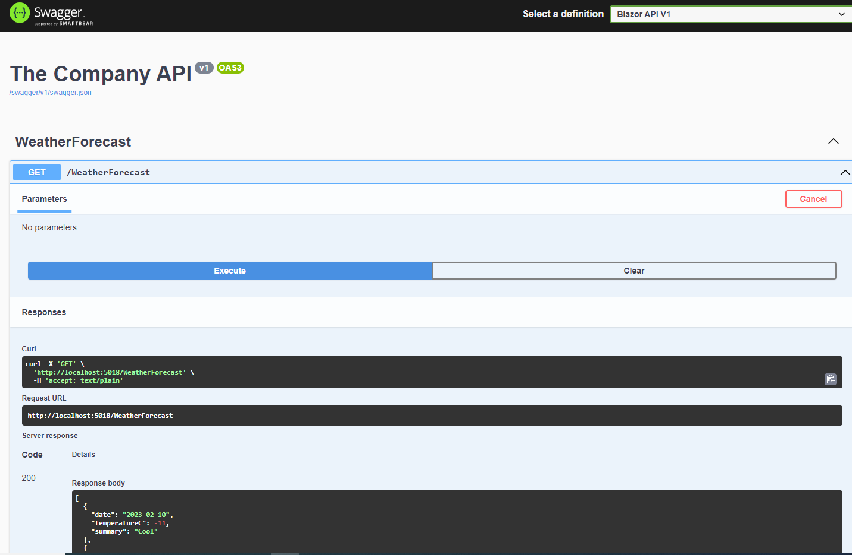
Blazor API (using Nswag Proxies)

Slide 15
Blazor API: Generate Proxies
Generate json and proxies in server .csproj:
<Target Name="RunNSwag" BeforeTargets="AfterBuild"> <Exec Command="$(NSwagExe_Net60) webapi2swagger /assembly:$(TargetPath) /output:..\Swagger\$(AssemblyName).swagger.json" />
<Exec Command="$(NSwagExe_Net60) swagger2csclient /input:..\Swagger\$(AssemblyName).swagger.json /output:..\Proxies\$(AssemblyName)Proxy.cs /Namespace:BlazorKnowledge.Proxies.$(AssemblyName) /UseBaseUrl:false /GenerateClientInterfaces:true" /> </Target>

Slide 16
Blazor API (using Nswag Proxies)
Register the proxy in Program.cs:
void ConfigureClient(HttpClient x) => x.BaseAddress = new Uri(builder.HostEnvironment.BaseAddress); builder.Services.AddHttpClient<IWeatherForecastClient, WeatherForecastClient>(ConfigureClient);
In .razor inject it:
@inject IWeatherForecastClient WeatherForecastClient
Call the API: _forecasts = await WeatherForecastClient.GetAsync();

Slide 17
Flux pattern
Often confused with Redux.
Redux is the name of a library,
Flux is the name of the pattern that Redux and Fluxor implement
The Flux pattern is distinguished by unidirectional flow of changes to a
Store that holds the application State
mediated by a Dispatcher that
directs dispatched Actions to the appropriate
Store functions (Reducers and Effects)
Reducers and Effects manage the State in a controlled manner

Slide 18
Fluxor
Immutable state
Fluxor is highly testable, separation of:
Actions (instructions)
Reducers (mutation functions)
Effects (asynchronous effects functions)
makes each part decoupled, testable and easier to grasp
Redux DevTools: time machine in browser for states

Slide 19
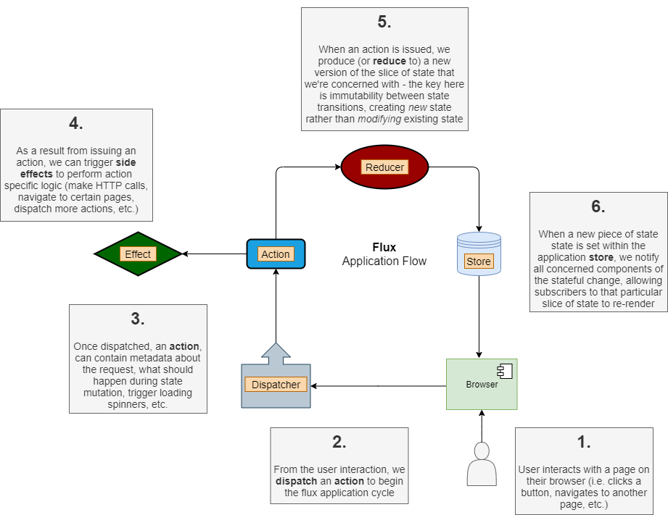
Fluxor
Flux pattern:
Like Redux
Manage State
Client-side

Slide 20
Fluxor
Rules:
State should always be read-only
Reducers create new states, not alter existing ones
To alter state our app should dispatch an Action
Reducer that processes the action type will create new state to reflect the old state combined with the changes expected for the action
(C# records are ideal for this)
The UI then uses the new state to render its display

Slide 21
Fluxor state exists in memory
A page refresh will flush the state
Optionally use Fluxor-persist
A library to persist Fluxor states
https://github.com/Tailslide/fluxor-persist
Or store in local storage

Slide 22
Blazor web application: Front to back
Client:
HTML + Tailwind = appearance
Blazor = component framework / C# in browser
Fluxor = state management
Proxy = interface via HTTP to server Controller
Server:
Controllers
Database access etc.

Slide 23
Code generators for boilerplate code
Fluxor (client-side state management)
Unit tests of fluxor dispatch action, effect, return

Slide 24
.NET modern features
Records
Nullable Reference Types
Dependency Injection (backend & frontend)
System.Text.Json (faster/default) no Newtonsoft
File-scoped namespaces

Slide 25
Testing
Xunit
Fluent assertions
Substitute

